Slide 1
第7章: Regulatory Network
Regulatory network
Reverse engineering
Bayesian network
Gaussian Graphical Model

Slide 2
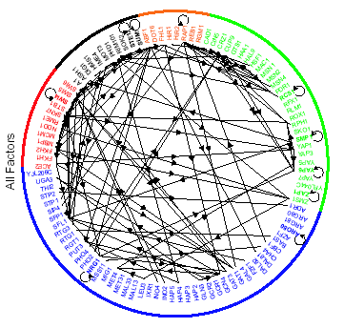
Part I: Regulatory Network
Lee et al. Science 2002.

Slide 3
Transcription Regulatory Code
Each gene is regulated by a set of TFs.
Each TF can regulate many genes.
Which genes are regulated by which TFs on which conditions?
How does regulator control the expression of its target gene?

Slide 4
How to Clarify Transcription Regulatory code ?
In silico.
From sequence to gene regulatory network.
Find all the potential TFBS upstream a gene.
Predict gene expression from gene sequence. Cell,2004.
Experimental methods
Gel shift
DNA footprinting.
Reporter genes
….
Not large scale
Not systematic
Too much noise!

Slide 5
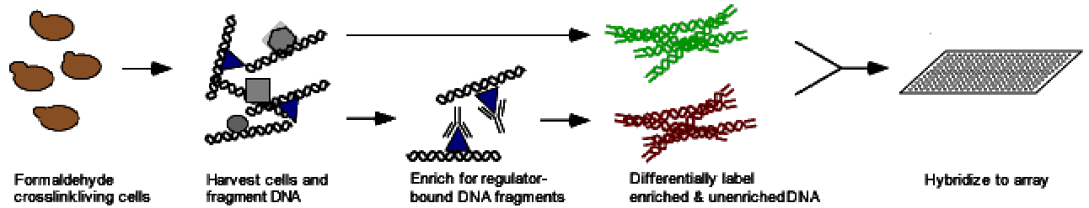
ChIP-chip Experiments
Identify all the target genes that can be directly or indirectly bind by a TF.

Slide 6
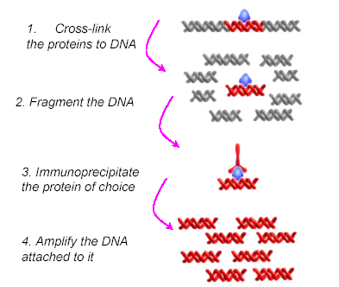
ChIP-chip Experiments

Slide 7
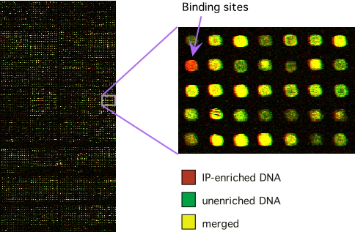
ChIP-chip Experiments

Slide 8
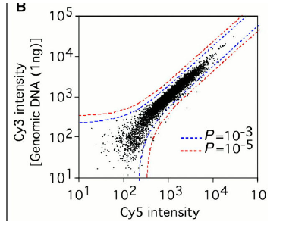
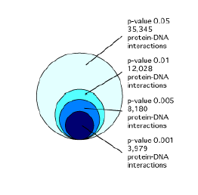
Protein-DNA Interactions
Lee, et al. Science, 2002.

Slide 9
ChIP-chip Experiments
1 condition , 1 TF
Jason et.al. Nature (2001). Promoter-specific binding of Rap1 revealed by genome-wide maps of protein-DNA association.
1 condition, 106 TFs
Lee et.al. Science(2002). Transcription regulatory networks in Saccharomyces cerevisiae
Multiple conditions , 203 TFs.
Harbison, et.al. (2004). Transcription regulatory code of a eukaryotic genome.

Slide 10
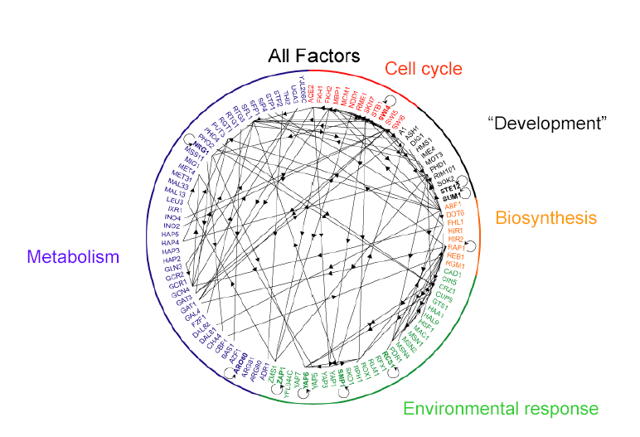
Lee, et al. Science, 2002.

Slide 11
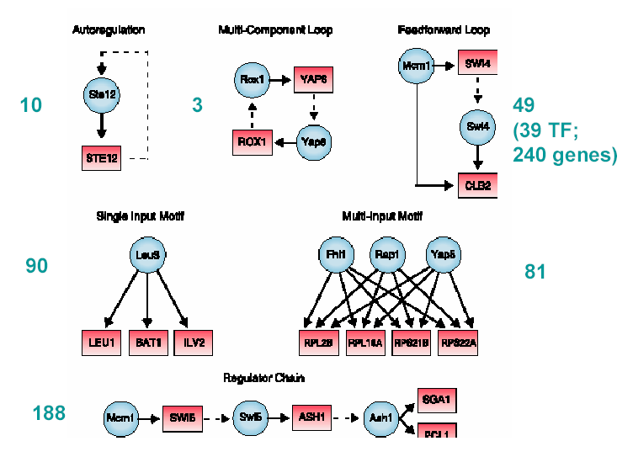
Lee, et al. Science, 2002.

Slide 12
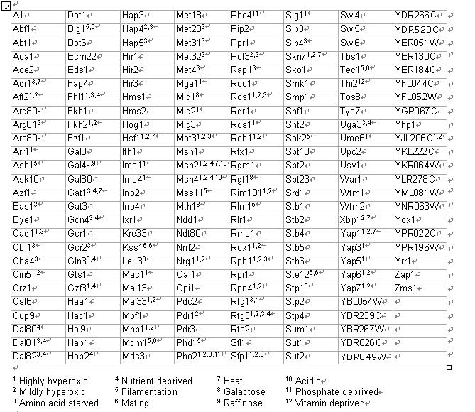
Multiple Conditions
*All regulators were profiled in rich medium
*A subset of these were profiled in at least one of 12 other environmental condition
Harbison et al. Nature 2004.

Slide 13
Part II: Reverse Engineering
Given: a (large) set of gene expression observations
Goal: find the network fits that observation data.
References:
Gardner, di Bernardo, Lorenz, and Collins. Inferring Genetic Networks and Identifying Compound Mode of Action via Expression Profiling. Science 301, pp.102-105 (2003)
Michael Hecker, Sandro Lambeck, Susanne Toepfer, Eugene van Someren, Reinhard Guthke. Gene regulatory network inference: Data integration in dynamic models—A review. BioSystems 96 (2009) 86–103.

Slide 14
DREAM Project
DREAM: Dialogue for Reverse Engineering Assessments and Methods.
Objective: To catalyze the interaction between experiment and theory in the area of cellular network inference and quantitative model building in systems biology.
http://www.the-dream-project.org/
http://sagebase.org/challenges-overview/2013-dream-challenges/ (DREAM8)

Slide 15
Modeling Expression with Differential Equations
Assumes network behavior can be modeled as a system of linear differential equations of the form:
x is a vector representing the continuous-valued levels (concentrations) of each network component
A is the network model: an N x N matrix of coefficients describing how each x_{i} is controlled by upstream genes x_{j}, x_{k}, etc.
u is a vector representing an external additive perturbation to the system

Slide 16
An example: From discrete- to continuous-valued networks
Three genes: x₁, x₂, x₃
x1 activates x2
x2 activates x1 and x3
x3 inhibits x1
x1
x2
x3
x1
x2
x3
dx/dt = Ax + u
dx₁/dt = a₁₂x₂ − a₁₃x₃
dx₂/dt = a₂₁x₁
dx₃/dt = a₃₂x₂

Slide 17
The steady state assumption
Near a steady-state point, expression levels do not change over time.
Under the steady-state assumption, the model reduces to 0 = Ax + u → Ax = −u
A straightforward method to infer A would be to apply N perturbations, u, to the network, in each case measuring steady-state expression levels for the x.
However, in larger networks it may be impractical to apply so many perturbations
As a simplifying assumption, consider that each gene has a maximum of k non-zero regulatory inputs.

Slide 18
The Inference Procedure
Ax = −u
Infer inputs to each gene separately
For the given gene, consider all possible combinations of the k regulatory inputs
For each combination, use multiple linear regression to determine optimal values of the k coefficients
Choose the combination that fits the observed data with the least error

Slide 19
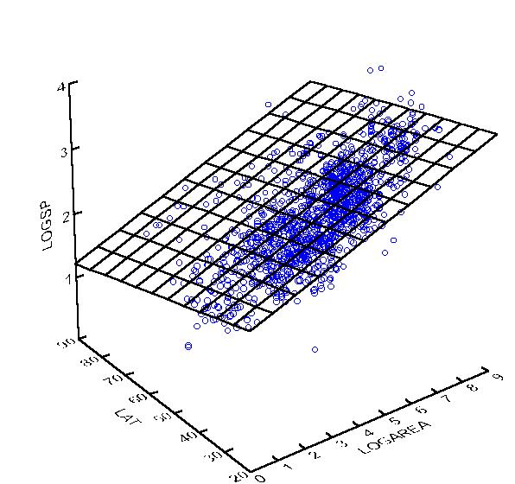
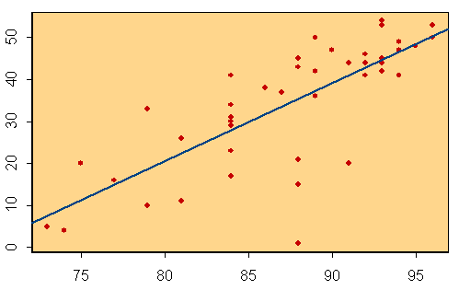
Multiple regression
u = −Ax
A is the fit
u
u
x
x₁
x₂

Slide 20
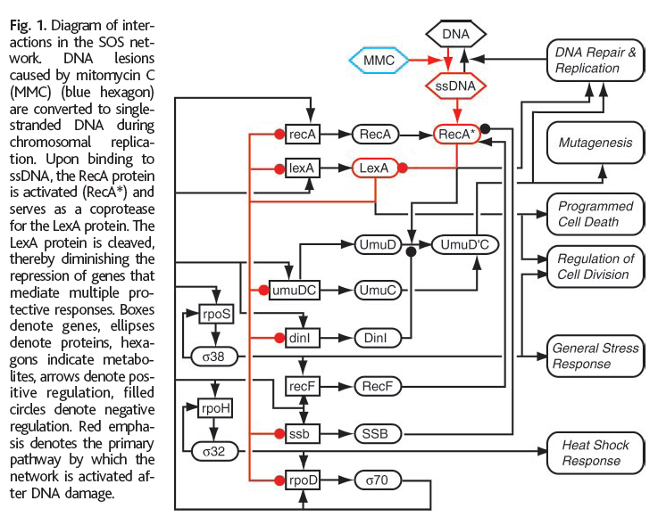
Application to SOS System
Gardner, di Bernardo, Lorenz, and Collins. Inferring Genetic Networks and Identifying Compound Mode of Action via Expression Profiling. Science 301, pp.102-105 (2003)

Slide 21
Part III: Bayesian Network
本部分Slides主要来自于N.Friedman and D.Heckman’s slides.
References:
N.Friedman et al. Using Bayesian Networks to analyze expression data. J. Comput. Biol., 7:601-620, 2000.

Slide 22
Motivation
Given gene expression data, what’s the relationship between genes?
Who regulates who?
How does does one gene regulate other gene?
Exploring the relationship among features to construct a better classifier instead of treating them independently.

Slide 23
Bayesian Network
Directed acyclic graph (DAG).
Nodes: random variables.
Edges: direct influence.
Set of conditional probability distributions.
Joint distribution.

Slide 24
Bayesian Networks: Example
Family of Alarm
Earthquake
Burglary
E
B
P(A | E,B)
e
b
0.9
0.1
e
b
0.2
0.8
Radio
Alarm
e
b
0.9
0.1
e
b
0.01
0.99
Call

Slide 25
Learning Problems
Estimation of the parameters.
Construct the structure.
Let’s start from the basic parameter estimation problem.

Slide 26
A: Learning Parameters

Slide 27
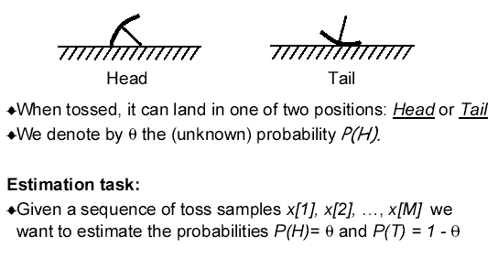
Simple Case: Binomial Experiment

Slide 28
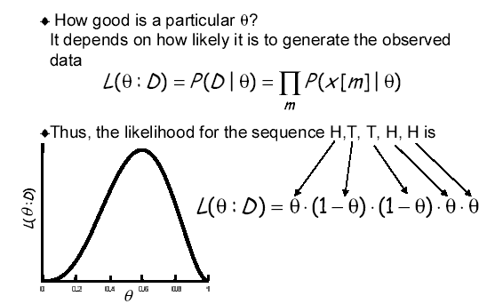
Likelihood Function

Slide 29
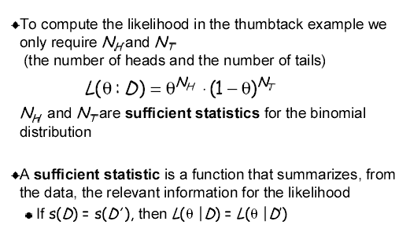
Sufficient Statistics

Slide 30
Maximum Likelihood Estimation (MLE)
MLE principle: Learn parameters that maximize the likelihood function.
This is one of the most commonly used estimation in statistics (Classical approach) and intuitively appealing.

Slide 31
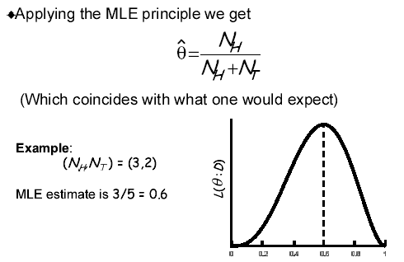
MLE In Binomial Case

Slide 32
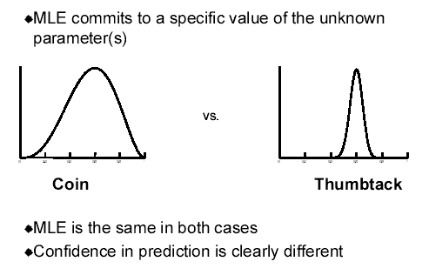
MLE is Not Enough

Slide 33
Bayesian Inference
Representing uncertainty about parameters using a probability distribution over parameters, data.
Using Bayes’ rule to learn.
Data (D) and their probability distribution
Prior distribution

Slide 34
Binomial Experiment Revised
Prior: Beta distribution
Posterior

Slide 35
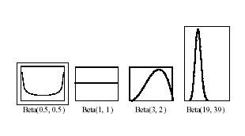
Beta Distribution

Slide 36
MAP (Maximum A-Posterior Probability)
Using MAP, we can obtain an estimation of the parameter
Recall that the MLE is

Slide 37
Intuition
The hyperparameters α_{H} and α_{T} can be thought of imaginary counts (psudo-counts) from our experience.
Equivalent sample size= α_{H} + α_{T}.
The larger the equivalent sample size, the more confident we are about the true probability.

Slide 38
Bayesian Inference vs. MLE
Frequentist approach
Assumes there is an unknown but fixed parameter
Estimates with some confidence
Prediction by using the estimated parameter value
Bayesian approach
Represents uncertainty about the unknown parameter
Uses probability to quantify this uncertainty: unknown parameters as random variables
Prediction follows from the rules of probability: take expectation over the unknown parameters

Slide 39
Bayesian Inference vs. MLE (Cont.)
In our example, MLE and Bayesian prediction differ.
However, If prior is well-behaved (does not assign 0 density to any feasible parameter value), then both MLE and Bayesian prediction converge to the same value, the ”true” distribution.

Slide 40
Learning Parameters
Training data has the form:
E
B
A
C

Slide 41
Likelihood Function
Assume i.i.d. samples
Likelihood function is
E
B
A
C

Slide 42
Likelihood Function
By definition of network, we get
E
B
A
C

Slide 43
Likelihood Function
Rewriting terms, we get
E
B
A
C
=
4 Subnetworks

Slide 44
General Bayesian Networks
Generalizing for any Bayesian network:
The likelihood decomposes to small ones according to the structure of the network.

Slide 45
General Bayesian Networks (Cont.)
Decomposition ⇒ Independent estimation problems
If the parameters for each family are not related, they can be estimated independently of each other.

Slide 46
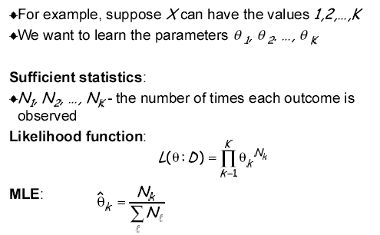
From Binomial to Multinomial

Slide 47
From Beta to Dirichlet Distribution
Prior: Dirichlet distribution
Posterior

Slide 48
From Beta to Dirichlet Distribution
The MAP is
The marginal likelihood is

Slide 49
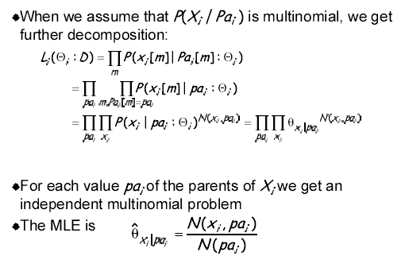
Likelihood for Multinomial Network

Slide 50
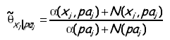
Bayesian Inference for Multinomial Network
Given data, we can compute the posterior for each multinomial independently. The posteriors are also Dirichlet with parameters
The predictive distribution is then represent by parameters

Slide 51
More Generalizations
Likelihood from exponential family.
Binomial distribution
Multinomial distribution
Poisson distribution
Gamma distribution
Normal distribution
Conjugated distributions.

Slide 52
Learning Parameters: Summary
Estimation relies on sufficient statistics
For multinomials: counts N(x_{i},pa_{i})
Parameter estimation
Both are asymptotically equivalent.
MLE
Bayesian (Dirichlet)

Slide 53
B. Learning Structure From Data

Slide 54
Why Struggle for Accurate Structure?
Truth
Earthquake
Alarm Set
Burglary
Sound
Missing an arc
Adding an arc
Earthquake
Alarm Set
Burglary
Earthquake
Alarm Set
Burglary
Sound
Sound
Cannot be compensated for by fitting parameters
Wrong assumptions about domain structure
Increases the number of parameters to be estimated
Wrong assumptions about domain structure

Slide 55
Score­based Learning
Define scoring function that evaluates how well a structure matches the data
E, B, A
<Y,N,N>
<Y,Y,Y>
<N,N,Y>
<N,Y,Y>
.
.
<N,Y,Y>
E
E
E
B
A
A
A
B
B
Search for a structure that maximizes the score

Slide 56
Score Function I
Which structure is good?
BDe scores (Heckman)
Marginal likelihood
Structure Prior

Slide 57
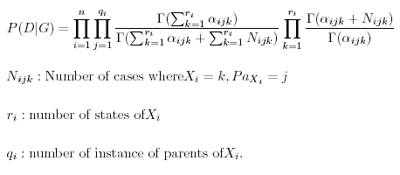
Marginal Likelihood (Multinomial Case)
If data are complete, we can obtain the close form.

Slide 58
Practical Consideration
Super exponential number (in the number of variables) of possible structures.
How do we find the best graphs?
How do we assign structure and parameter priors to all possible graphs?

Slide 59
Structure Prior Choice
All possible structures are equally likely.
Fix (or forbid) some arcs.
Choosing a prior proportions to the similarity to a prior network structure.

Slide 60
Model Selection
Theorem: finding the best BN structure among those structures with at most k parents in NP-hard problem (k>1).
Heuristic searching.
Greedy.
MCMC.

Slide 61
Score Function II
Which structure is good?
BIC/MDL scores
BIC: Bayesian Information Criterion.
MDL: Minimum Description Length.
Fitness to data
Complexity regularization

Slide 62
Minimum Description Length Principle
Universal coding.
Description length of the compressed form (model) of data.
Description length of the model itself used in the compression.

Slide 63
Minimum Description Length Principle (Cont.)
Bayesian network case.
Modeling of data (Probability distribution).
Network coding (number of parameters).
See: N.Friedman. Learning Bayesian networks with local structure.

Slide 64
Decomposability
Key property of the Bayesian network with complete data.
score(G) = ∑ score ( family of X in G )

Slide 65
Tree-structured Networks
Trees: At most one parent per variable.
Why trees?
Elegant math=>we can solve the optimization problem
Sparse parameterization to avoid over-fitting
MINVOLSET
PULMEMBOLUS
INTUBATION
KINKEDTUBE
VENTMACH
DISCONNECT
PAP
SHUNT
VENTLUNG
VENITUBE
PRESS
MINOVL
VENTALV
PVSAT
ARTCO2
TPR
SAO2
INSUFFANESTH
EXPCO2
HYPOVOLEMIA
LVFAILURE
CATECHOL
LVEDVOLUME
STROEVOLUME
HISTORY
ERRBLOWOUTPUT
HR
ERRCAUTER
CVP
PCWP
CO
HREKG
HRSAT
HRBP
BP

Slide 66
Learning Trees
Let p(i) denote parent of X_{i}
The Bayesian score can be written as sum of edge scores.
Improvement over
“empty” network
Score of “empty”
network

Slide 67
Learning Tree
Set edge weight as: Score( X_{j} → X_{i} ) - Score(X_{i}).
Well studied Problem in graph theory: Find the tree with maximum weight. It can be solved by maximum spanning tree algorithm (MST) in an efficient way.

Slide 68
Kruskal’s Algorithm on MST
begin Kruskal;
sort the arcs in A in decreasing order of their weights;
LIST = ∅;
while |LIST| < n – 1 do
begin
if the next arc does not create a cycle then add
it to LIST
else discard it
end;
end;

Slide 69
Heuristic Search: Beyond Trees
Define a search space:
search states are possible structures
operators make small changes to structure
Search techniques:
Greedy hill-climbing
Best first search
Simulated Annealing
...

Slide 70
Local Search
Start with a given network
empty network
best tree
a random network
At each iteration
Evaluate all possible changes
Apply change based on score
Stop when no modification improves score

Slide 71
Typical Operations In Heuristic Search
Add C →D
S
C
S
C
S
C
E
Delete C →E
E
E
Reverse C →E
D
Δscore =
S({C,E} →D)
- S({E} →D)
D
D
To update score after local change,
only re-score families that changed
S
C
E
D

Slide 72
Local Search: Possible Pitfalls
Local search can get stuck in:
Local Maxima:
All one-edge changes reduce the score
Plateaus:
Some one-edge changes leave the score unchanged

Slide 73
Escape From Traps
Random restarts.
Simulated annealing
Take the bad score with probability proportion to exp(Δscore/t).
Cool down slowly.

Slide 74
Discovering Structure
P(G|D)
E
B
R
A
C
Current practice: model selection
Pick a single high-scoring model
Use that model to infer domain structure

Slide 75
Discovering Structure
P(G|D)
E
B
E
B
E
B
E
B
E
B
R
A
R
A
R
A
R
A
R
A
C
C
C
C
C
Problem
Small sample size ⇒ many high scoring models
Answer based on one model often useless.
We want features common to many models.

Slide 76
Bayesian Approach
Posterior distribution over structures
Estimate probability of features
Edge X→Y
Path X→… → Y
…
Bayesian score
for G
Feature of G,
e.g., X→Y
Indicator function
for feature f

Slide 77
Practical Implementation
Bootstrap method.
Randomly generate m “perturbed” sample sets.
For each sample set, choose a best model G_{i}.
Average the feature among these m structures.

Slide 78
C: Dealing With Missing Data
Structure known, how to learn the parameters?
Structure unknown, how to learn the structure and parameters?

Slide 79
Incomplete Data
Data is often incomplete
Some variables of interest are not assigned values.
This phenomenon happens when we have
Missing values:
Some variables unobserved in some instances
Hidden variables:
Some variables are never observed
We might not even know they exist

Slide 80
Hidden (Latent) Variables
Why should we care about unobserved variables?
X₁
X₂
X₃
X₁
X₂
X₃
H
Y₁
Y₂
Y₃
Y₁
Y₂
Y₃
17 parameters
17=1+1+1+8+2+2+2
27 parameters
27=1+1+1+8+8+8

Slide 81
More Computation
The likelihood of the data does not decompose.
Complete data.
Incomplete data.

Slide 82
Learning Parameters With Incomplete Data
Expectation maximization (EM) iteration algorithm is the general purpose method for learning from incomplete data.
E-Step.
M-Step.

Slide 83
EM Intuition
If we had true counts, we could estimate parameters.
But with missing values, counts are unknown.
We “complete” counts using probabilistic inference based on current parameter assignment.
We use completed counts as if real to re-estimate parameters.

Slide 84
EM Algorithm
Data
Expected Counts
P(Y=H|X=H,Z=T,Θ) = 0.3
X
Y
Z
N (X,Y )
HTHHT
??HTT
T??TH
X
Y
#
Current
model
HTHT
HHTT
1.30.41.71.6
P(Y=H|X=T,Θ) = 0.4

Slide 85
EM Algorithm (Cont.)
Reiterate
Initial network (G,Θ₀)
Expected Counts
N(X₁)
N(X₂)
N(X₃)
N(H, X₁, X₁, X₃)
N(Y₁, H)
N(Y₂, H)
N(Y₃, H)
Updated network (G,Θ₁)
X₁
X₂
X₃
X₁
X₂
X₃
X₁
X₂
X₃
H
Computation
Reparameterize
H
H
Y₁
Y₂
Y₃
(E-Step)
(M-Step)
+
Y₁
Y₂
Y₃
Y₁
Y₂
Y₃
Training
Data

Slide 86
EM Algorithm (Cont.)
Formal Guarantees:
L(Θ₁:D) ≥ L(Θ₀:D)
Each iteration improves the likelihood
If Θ₁ = Θ₀ , then Θ₀ is a stationary point of L(Θ:D)
Usually, this means a local maximum

Slide 87
Computational Bottleneck
Computation of expected counts in E-Step
Need to compute posterior for each unobserved variable in each instance of training set.
All posteriors for an instance can be derived from one pass of standard BN inference.

Slide 88
Summary: Parameter Learning With Incomplete Data
Incomplete data makes parameter estimation hard
Likelihood function
Does not have closed form
Is multimodal
Finding maximum likelihood parameters:
EM
Gradient ascent
Both exploit inference procedures for Bayesian networks to compute expected sufficient statistics

Slide 89
Incomplete Data: Structure Scores
Recall, Bayesian score:
With incomplete data:
Cannot evaluate marginal likelihood in closed form.
We have to resort to approximations:
Evaluate score around MAP parameters
Need to find MAP parameters (e.g., EM)

Slide 90
Naïve Approach
Perform EM for each candidate graph.
Computationally expensive:
Parameter optimization via EM — non-trivial
Need to perform EM for all candidate structures
Spend time even on poor candidates
In practice, considers only a few candidates.

Slide 91
Structural EM
Recall, in complete data we had
Decomposition ⇒ efficient search.
Idea:
Instead of optimizing the real score…
Find decomposable alternative score.
Such that maximizing new score ⇒ improvement in real score.

Slide 92
Structural EM (Cont.)
Idea:
Use current model to help evaluate new structures
Outline:
Perform search in (Structure, Parameters) space.
At each iteration, use current model for finding either:
Better scoring parameters: “parametric” EM step.
Better scoring structure: “structural” EM step.

Slide 93
Structural EM Steps
Assume B₀ = (G₀,Θ₀) is “current” hypothesis.
Goal: Maximize expected score, given B₀
where D⁺ denotes completed data sets.
Theorem:(progress)
If E[Score(B : D⁺) | D,B₀] > E[Score(B₀ : D⁺) | D,B₀]
⇒ Score(B : D) > Score(B₀ : D).
This implies that by improving the expected score, we find networks that have higher objective score.

Slide 94
Structural EM for BIC/MDL
For the BIC/MDL score, we get that
Consequence:
We can use complete-data methods, where we use expected counts, instead of actual counts.

Slide 95
Reiterate
Score
&
Parameterize
Computation
X₁
X₂
X₃
Expected Counts
N(X₁)
N(X₂)
N(X₃)
N(H, X₁, X₁, X₃)
N(Y₁, H)
N(Y₂, H)
N(Y₃, H)
X₁
X₂
X₃
H
H
Y₁
Y₂
Y₃
+
Y₁
Y₂
Y₃
Training
Data
N(X_{2,}X₁)
N(H, X₁, X₃)
N(Y₁, X₂)
N(Y₂, Y₁, H)
X₁
X₂
X₃
X₁
X₂
X₃
H
H
Y₁
Y₂
Y₃
Y₁
Y₂
Y₃

Slide 96
The Structural EM Procedure
Input: B₀ = (G₀,Θ₀)
loop for n = 0,1,… until convergence
Improve parameters:
Θ`_{n} = Parametric-EM (G_{n},Θ_{n} )
let B`_{n}= (G_{n`},Θ`_{n})
Improve structure:
Search for a network B_{n+1} = (G_{n+1},Θ_{n+1}) s.t.
E[Score(B_{n+1}:D) | B`_{n}] > E[Score(B`_{n}:D) | B`_{n}]
Parametric-EM() can be replaced by Gradient Ascent, Newton-Raphson methods, or accelerated EM.
Early stopping parameter optimization stage avoids “entrenchment” in current structure.

Slide 97
App1: Expression Data Analysis
Reference:
N.Friedman et al. Using Bayesian Networks to analyze expression data. J. Comput. Biol., 7:601-620, 2000.
A.Hartemink et al. Combining location and expression data for principled discovery of genetic regulatory network models. PSB 2002.

Slide 98
Motivation
Extract meaningful information from gene expression data.
Infer regulatory mechanism.
Reveal function of proteins.
……

Slide 99
Case 1: Cell-cycle Data
Yeast cell-cycle data (P.Spellman, Mol. Biol. of the cell, 1998).
7 time series under different cell cycle synchronization methods (alpha, beta factor, CDC15, CDC24, CDC28,cln2,3).
6177 ORFs, 77 time points.
800 genes are identified related to cell cycle process (big variation).

Slide 100
Bayesian Network Model
Random Variables
Individual genes
Experimental condition
Cell phase.
Discretization: 3 levels, -1,0,1, depending on whether the expression level is significantly lower than, similar to, great than the respective control. However, this may not be necessary (For continuous variable, a linear Gaussian conditional model can be used).

Slide 101
Learning Bayesian Network (Cont.)
Sparse candidate algorithm: identify small number of candidate parents for each gene based on simple local statistics (such as mutual information).
Bootstrap confidence estimation:
Use re-sampling to generate perturbations of training data.
Use the number of times of feature is repeated among networks from these datasets to estimate confidence of Bayesian network features.

Slide 102
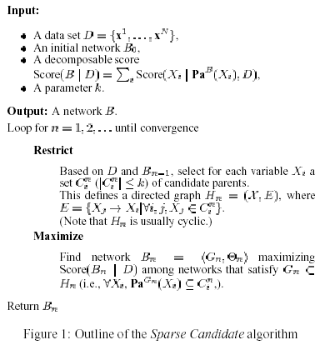
Sparse Candidate Algorithm

Slide 103
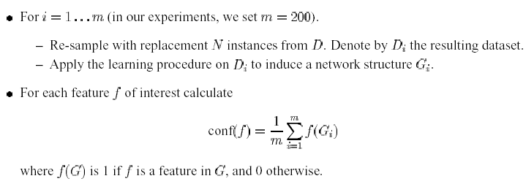
Estimate Feature Significance Bootstrap Method

Slide 104
Markov Relation
Pairs with 80% confidence were evaluated against original clustering.
70% of these were intra-cluster.
The rest show interesting inter-cluster relations.
Most pairs are functionally related.

Slide 105
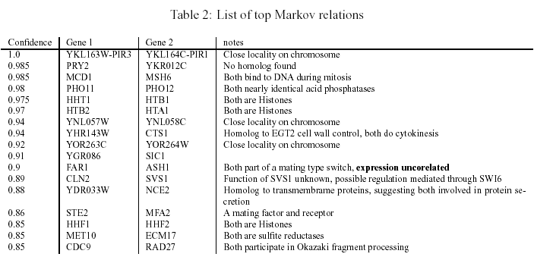
Markov Relation (Cont.)

Slide 106
Order Relation
Dominant gene: genes are indicative or potential source of the cell-cycle process.
Dominance score: describing how strong that one gene can be the ancestor of other genes in the network.

Slide 107
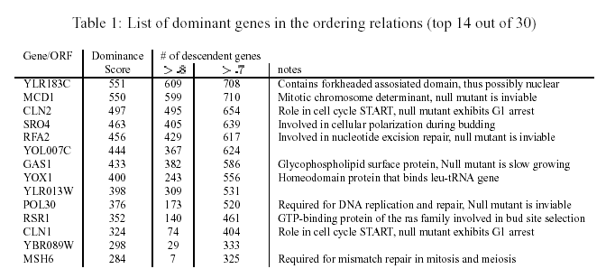
Dominant Genes
Cell cycle control and initiation: CLN1, CLN2, CDC5.
……

Slide 108
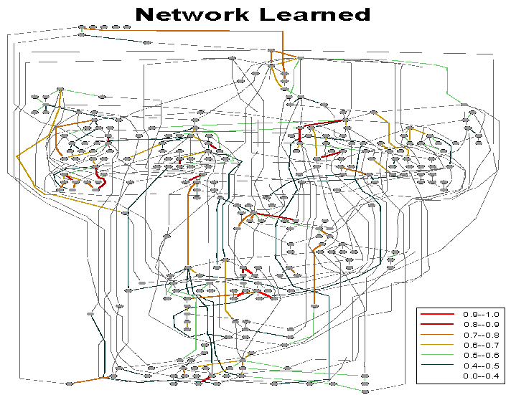

Slide 109
Case 2: Pheromone and Mating Response
6135 genes, 320 samples under different conditions.
32 genes are selected.
Pheromone response signaling pathway.
Mating response.
Location data (transcription factor and DNA binding experiment, chip-chip data) are included as prior constraints.

Slide 110
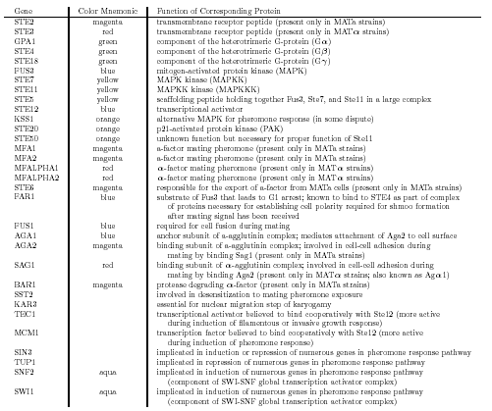
Genes Selected

Slide 111
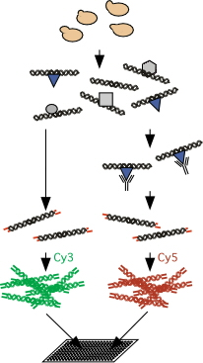
Location Analysis (Chip-chip)
Crosslink protein to DNA in vivo with formaldehyde
Break open cells and shear DNA
Immunoprecipitate
Reverse-crosslinks, blunt DNA and ligate to unidirectional linkers
LM-PCR
Hybridize to array
http://inside.wi.mit.edu/young/pub/locationanalysis.html

Slide 112
Bayesian Network Model
Random variables
32 genes.
Mating type (Mata, Matα).
Discrimination: to 4 levels while preserving over 98% of the original total mutual information between pairs of genes.
Location data: set the constraints specifying which edges are required to be present and which are required to be absent.

Slide 113
Learning Bayesian Network
Score: Bayesian score metric (BSM).
Local heuristic searching algorithm: simulated annealing.
Caching: keeping the top 500 structures recorded.
Feature induction: Average features within top 500 structures.

Slide 114
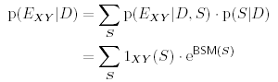
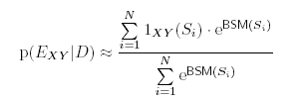
Learning Bayesian Network (Cont.)
Approximation:

Slide 115
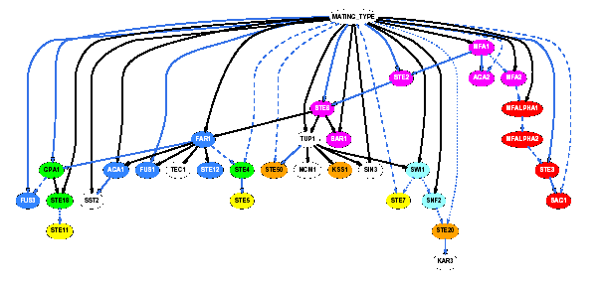
Learned Network Without Constraint
Node color: Different function.
Edge color:Solid black (0.99-1.0), dash blue (0.75-0.99), dot blue (0.5-0.75).

Slide 116
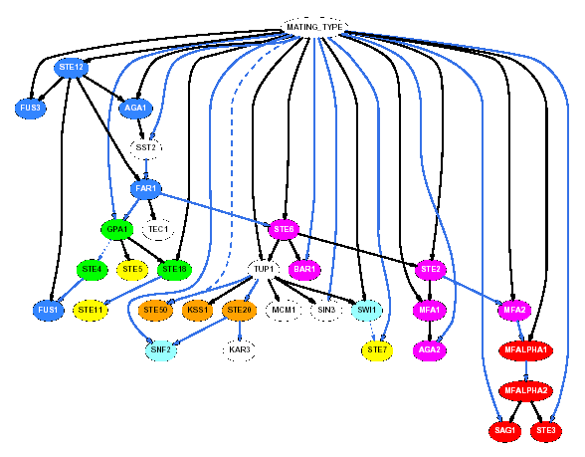
Learned Network With Constraints
Constraints included:
STE12
FUS1
FUS3
AGA1
FAR1

Slide 117
App2. Bayesian Classifier
Reference:
N.Friedman. Building classifier using Bayesian networks. Proc. NCAI 1277-1284, 1996.
O.D.King et al. Predicting Gene Function From Patterns of Annotation. Genome Research 13: 896-904, 2003.

Slide 118
Basic Problem
Given a dataset
{(X_{1,}c), (x_{2,}c),… ,(X_{N-1,}c), (X_{N,}c)}
Here X_{i} stands for the training data,c stands for the class label,assuming we have m classes,
We estimate the probability.
P(C_{i} |X), i=1,2,…,m
The classifier is then denoted by:
How can we estimate the posterior probability?

Slide 119
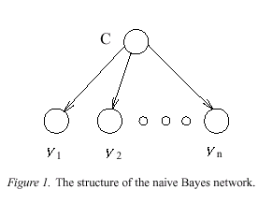
Naïve Bayesian Network
Assumption: all the variables are independent, given the class label.
Joint distribution.

Slide 120
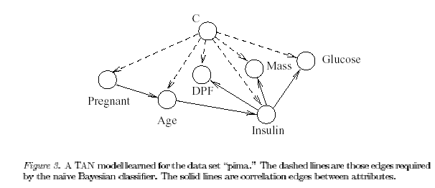
Tree Argumented Naive Bayes (TAN) Model
Bayesian network with the class as the root, will each attribute’s parent set contain class and at most one other attribute.

Slide 121
最大权值相关树
用一个相关树来近似变量的联合分布
其中 表示i的父节点所对应的随机变量。
采用相对熵描述分布的差异
可以证明，最小化相对熵等价于极大化下面的互信息和

Slide 122
最大权值相关树
算法(MWDT, Maximum Weight Dependence Tree), 即为生成树的Kruskal算法
1. 对所有p(p-1)/2个变量对，计算其分支权值，并按降序排列
2. 将权值最大的两个分支放入树中
3. 如果没有形成闭环，则将下一个权值最大的分支加入树中，否则将其抛弃，重复此过程直到p-1个分支已经被选择
4. 选择任意的根节点，计算概率分布

Slide 123
GO Function Prediction
Motivation: GO is the controlled vocabulary of gene functions. Predict gene function by the pattern of annotation.
Idea: If the annotation of two attribute tend to occur together in the database, then a gene holding one attribute is likely to hold the other as well.

Slide 124
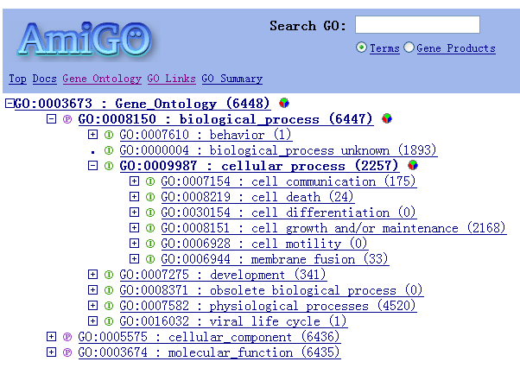
Gene Ontology Structure

Slide 125
Formalization
GO attributes j. X_{j} indicate function. X_{j}(i)=1 if gene is annotated with j.
Attribution set nad(x_{j}): neither ancestor nor descendant attribute of one attribute j in the GO DAG.
The task is to estimate the probability

Slide 126
Bayesian Network Model
Nodes: GO attribute covers more than 10 genes, and no descendant covers more than 10 genes.
SGD, 170.
FlyBase, 218.
Constraints: just considering those structures logically consist with GO DAG.

Slide 127
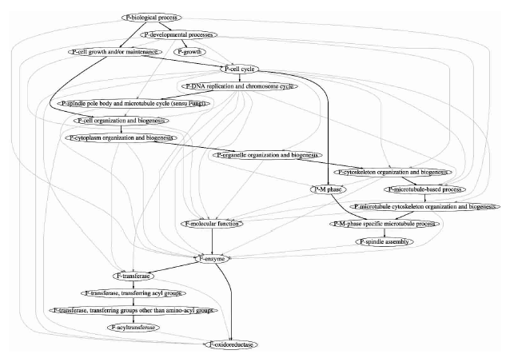
Fragment of Learned Bayesian Network

Slide 128
Further Reading
N.Friedman et al. A structural EM algorithm for phylogenetic inference. RECOMB2001.
E.Segal et al. From promoter sequence to gene expression data. RECOMB2002.
E.Segal. Regulatory module. Nature Genetics 34: 2003.

Slide 129
Bayesian Network Sourses
Peoples
N.Friedman http://www.cs.huji.ac.il/~nir/
D.Heckman http://www.research.microsoft.com/~heckerman/
J. PEARL http://bayes.cs.ucla.edu/jp_home.html
F.V.Jensen http://www.cs.auc.dk/~fvj/
……

Slide 130
Bayesian Network Sourses
Bayesian Network Repository http://www.cs.huji.ac.il/labs/compbio/Repository/.
Systems
Bayesian Networks Software Package listing http://www.cs.berkeley.edu/~zuwhan/bn.html.
Microsoft Belief Network Tools http://www.research.microsoft.com/research/dtg/msbn/
Hugin http://hugin.dk/
……

Slide 131
Part IV Gaussian Graphical Model

Slide 132
Multivariate Gaussian Distribution
Multivariate Gaussian over all continuous expressions
MRF表示

Slide 133
Multivariate Gaussian Distribution
定理：如果 可逆，那么
其中
证明：由

Slide 134
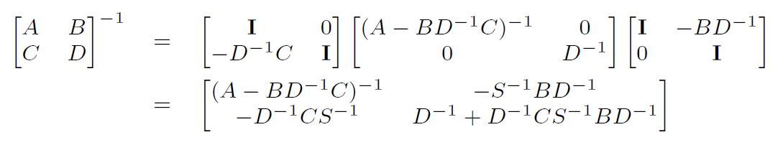
Multivariate Gaussian Distribution
得到
其中

Slide 135
Multivariate Gaussian Distribution
定理：对于多元高斯模型，有如下结论
(1).
(2).

Slide 136
Multivariate Gaussian Distribution
证明：考虑变量的划分i和V₂, , 设
并令

Slide 137
Multivariate Gaussian Distribution
由分块矩阵求逆得到
进一步将V₂划分为j和B, , 并设
可得

Slide 138
Multivariate Gaussian Distribution
所以

Slide 139
Multivariate Gaussian Distribution
另一方面，对于联合高斯模型，条件 的分布仍然是高斯分布，而且
所以

Slide 140
Multivariate Gaussian Distribution
因此
而
因此 等价于上述回归方程中的系数

Slide 141
Precision Matrix
The precision matrix reveals the topology of the (undirected) network G=(V, E)

Slide 142
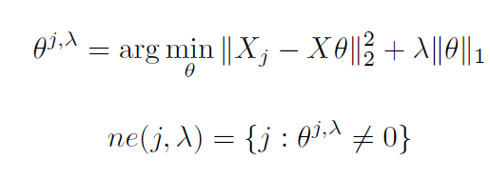
Neighborhood Selection
For each j, let

Slide 143
L1-loglikelihood
Likelihood
Log-likelihood
Penalized log-likelihood Maximization

Slide 144
References
D.Heckman. A tutorial on learning with Bayesian Network.
N.Friedman. Learning bayesian networks with local structure.
D.Heckman. Bayesian Networks for data mining. Data Mining and Knoledge Dicovery 1: 79-119, 1997.
N.Friedman. Using bayesian networks to analyze expression data. J. Comp. Biol. 2002.
A.Hartemink Combining location and expression data for principled discovery of genetic regulatory network models. PSB2002.
O.D.King et al. Genome Res. 13: 896-904. 2003.
Novershtern N, Subramanian A, Lawton LN, Mak RH, Haining WN, McConkey ME, Habib N, Yosef N, Chang CY, Shay T, Frampton GM, Drake AC, Leskov I, Nilsson B, Preffer F, Dombkowski D, Evans JW, Liefeld T, Smutko JS, Chen J, Friedman N, Young RA, Golub TR, Regev A, Ebert BL. Densely interconnected transcriptional circuits control cell states in human hematopoiesis. Cell. 144(2):296-309. 2011.

